Slide 1
Event Planning Web-based Application
WebIt: Krishna Viradia, Courtney Burns, Sara Nazir, Wubnyonga Tete, Theresa Tomilson, Mehak Uddin, Nuri Ousman

Slide 2
Project Background
Customer: Vicky Tawle is an event planner (Entrepreneur)
Works from the comfort of her home
Documents her business manually (pen and paper)
Has had issues with consistency and accuracy with her recordkeeping.

Slide 3
Systems Request
Business Need
Project has been initiated to create an online database that will be accessible and updatable by the user via a dynamic web-based application.
Will allow the user to store customer information, services rendered and their costs, invoice totals, and event information
Competitors have transitioned to a computer-based record-keeping system.

Slide 4
Systems Request
Business Requirement
A dynamic web-based application with an integrated, updatable back-end database will be created. The database must satisfy the following customer needs:
Store and update event scheduling and event information
Store and update customer information
Calculation of services rendered
Calculation of invoice totals

Slide 5
Systems Request
Business Value
The value of the web-based database application will provide:
Immediate and convenient accessibility to business information
15% increase in productivity
Accurate invoice calculations will increase by 50%
Reduce inventory expenses by 10%

Slide 6
Systems Request
Special Constraints
The project has to be completed within three months
Contents of the database are limited to Tawle and any other personnel she allows access to the database.

Slide 7
Feasibility Analysis
Technical Feasibility Analysis
In order to create the web-application, we will use:
MySQL software
PHP elements
phpMyAdmin
WordPress.com
The end-user will need Internet access and a computer that can support moderate web-browsing
Once the web-application and database are integrated, maintaining records and information will be left solely up to the end-user.
Notes:
phpMyAdmin to integrate the database to the dynamic front-end created through WordPress.com

Slide 8
Feasibility Analysis
Organizational Feasibility
Tawle is open to accept the any risk that comes with the project
Tawle is the sole business owner and operator
Upkeep of the database and its records are left up to Tawle
Tawle’s interaction with the database will remain within the front-end of the application

Slide 9
Feasibility Analysis
Economic Feasibility
A user friendly system that improves job satisfaction
A new scheduling system that improves efficiency
Tracking invoices will help in marketing decision making.
This new web interface increases efficiency and reliability of records.

Slide 10
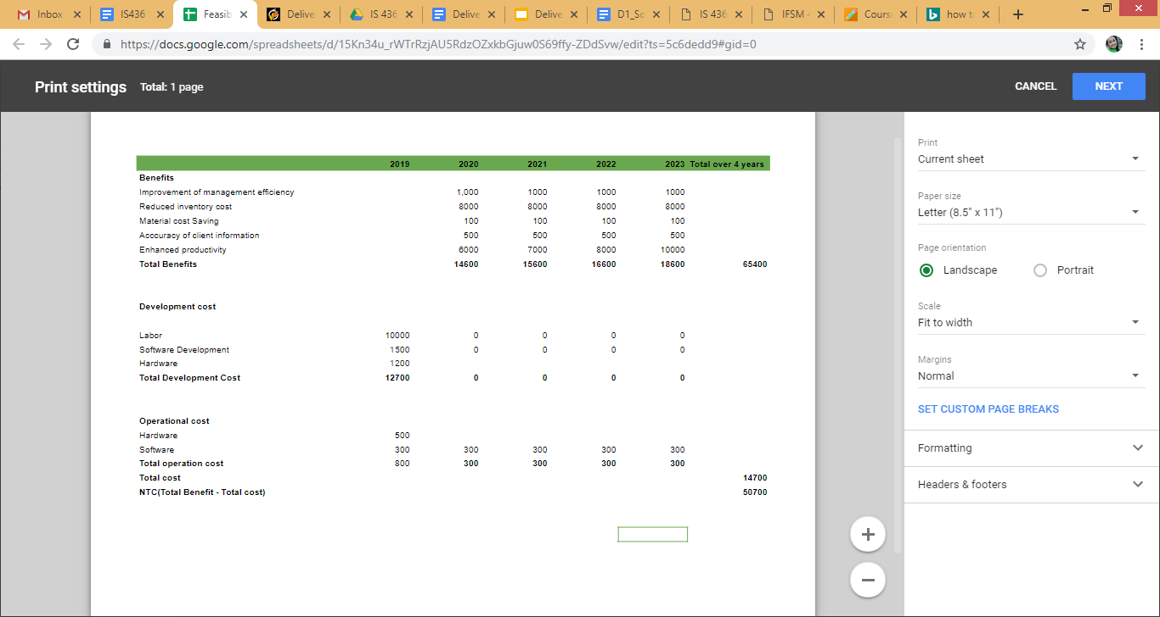
Economic Feasibility (Continued)

Slide 11
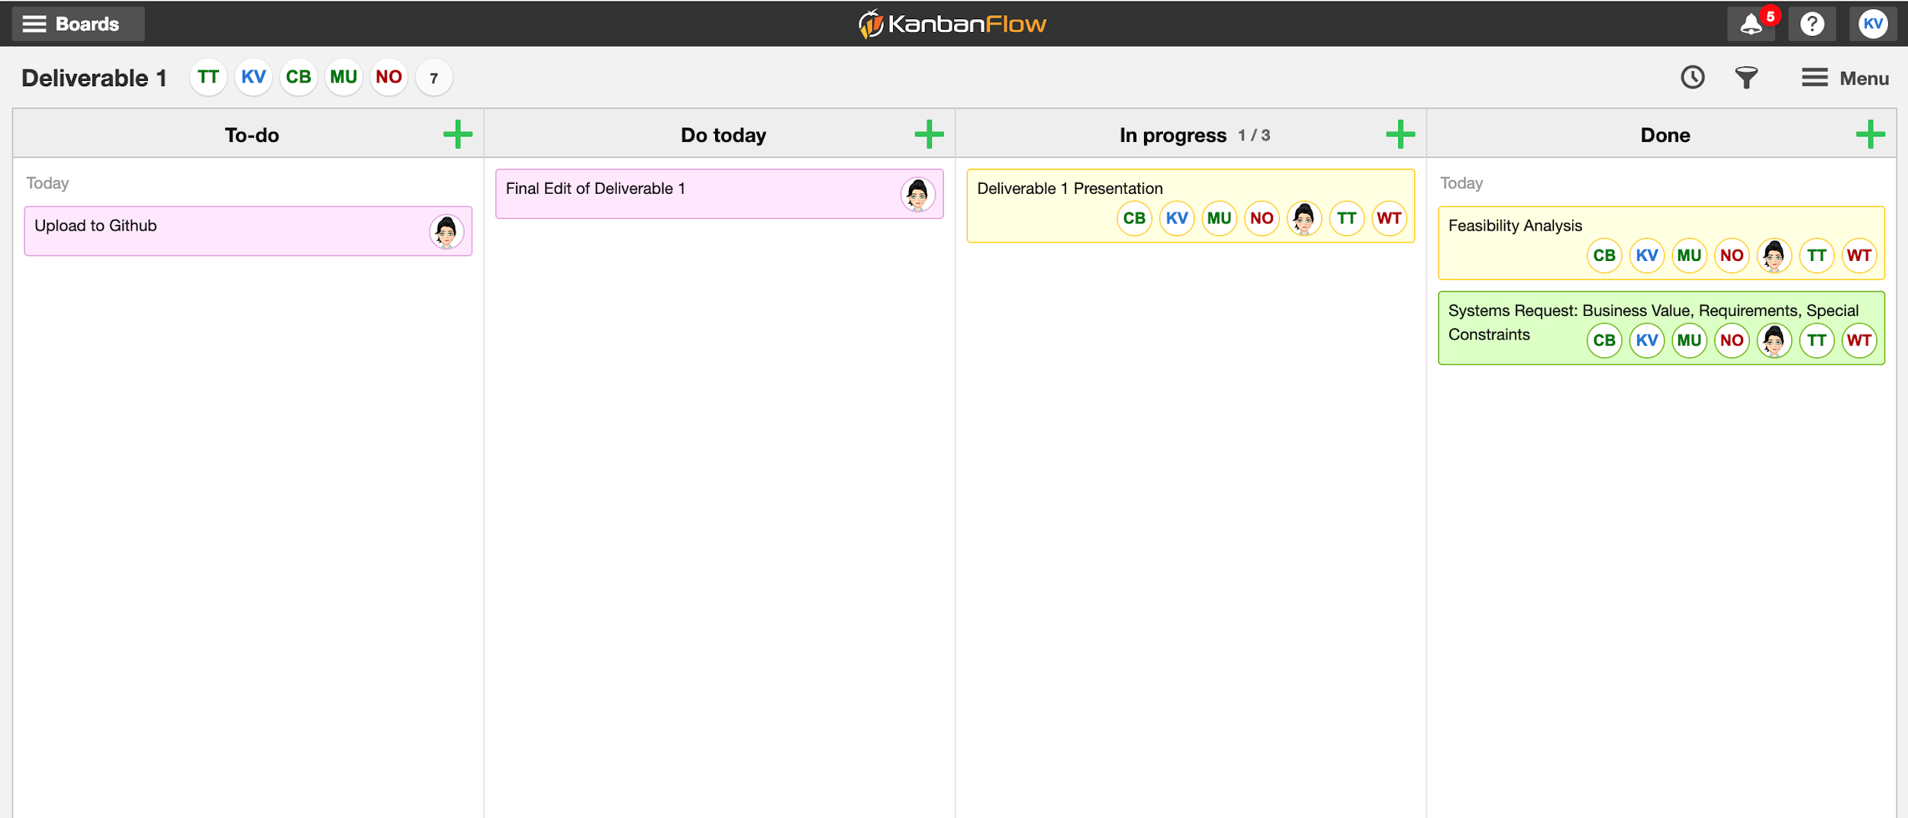
KanbanFlow

Slide 12


